Slide 1
FUZZY SYSTEMS
Jaya Sil
Indian Institute of Engineering Science and Technology, Shibpur
Howrah-711103

Slide 2
History
The precision of mathematics owes its success due to the efforts of Aristotle and his predecessors.
Their efforts led to a concise theory of logic and Mathematics.
The “Law of the Excluded Middle,” states that every proposition must either be True or False.
There were strong and immediate objections, Heraclitus proposed that things could be simultaneously True and not True.

Slide 3
History
Plato laid a foundation for fuzzy logic, indicating that there was a third region (beyond True and False).
Lukasiewicz proposed a systematic alternative to the bi-valued logic of Aristotle describing a three-valued logic where the third value translated as “possible,” and assigned a numeric value between True and False.
Later, he explored four-valued, five-valued logics, and declared that in principle there was nothing to prevent the derivation of an infinite-valued logic.
Knuth proposed three-valued logic, the integral range [-1,0,+1]

Slide 4
History
In the 1960s, Lotfi Zadeh invented fuzzy logic, which combines the concepts of crisp logic and the Lukasiewicz sets by defining graded membership.
One of Zadeh's main insights was that mathematics can be used to link language and human intelligence.
Many concepts are better defined by words than by mathematics, and fuzzy logic and its expression in fuzzy sets provide a discipline that can construct better models of reality.
Zadeh developed fuzzy logic as a way of processing data, where a data element to be either a member or non-member of a set, he introduced the idea of partial set membership.

Slide 5
The Fuzzy World
Fuzzy in the real-world sense, like "going forward slowly" or "a bit hungry" or "partly cloudy"—the distinctions that people use in decision-making all the time.
However, computers and other advanced technology haven't been able to handle complex and dynamic situations.
Fuzzy techniques successfully handle real world situations.
In 1974 Mamdani and Assilian used fuzzy logic to regulate a steam engine.
In 1985 researchers at Bell laboratories developed the first fuzzy logic chip.

Slide 6
Merits and Demerits
There are five types of systems where fuzziness is beneficial:
• Complex systems that are difficult or impossible to model
• Systems controlled by human experts
• Systems with complex and continuous inputs and outputs
Systems that use human observation as inputs or as the basis for rules
Systems that are naturally vague, such as those in the behavioral and social sciences.
Though easier to design and faster to prototype than conventional control systems, fuzzy systems require more simulation and fine tuning before they're operational.

Slide 7
Motivation
Boolean logic assumes that every fact is either entirely true or false.
Crisp logic, adequate for handling situation having certainty. But life is often more complex, your answer Yes or No inappropriate and you need more information.
The term “fuzzy logic” refers to a logic of approximation.
Fuzzy logic allows for varying degrees of truth.
Computers can apply this logic to represent vague, ambiguous and imprecise ideas, such as “hot”, “tall” or “good”.

Slide 8
Introduction
Natural language employs many vague and imprecise concepts.
It might be argued that vagueness is an obstacle to clarity of meaning and answering by YES or NO is less precise.
Translating such statements into more precise language removes some of their semantic value.
This is what happens when natural language is translated into classic logic.
The loss is severe when the issue is related to queries and knowledge.
Fuzzy logic actually contains crisp logic as an extreme.

Slide 9
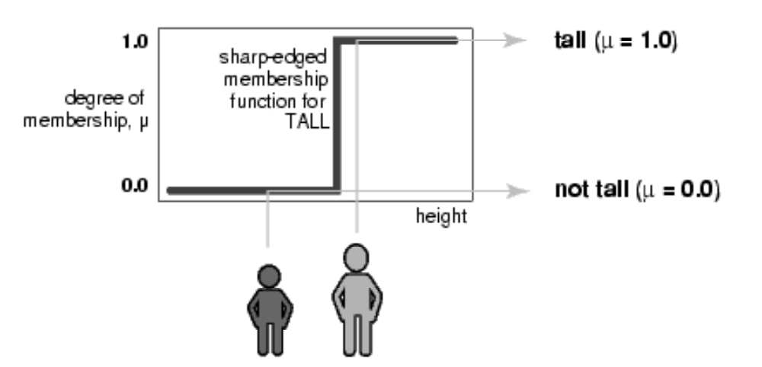
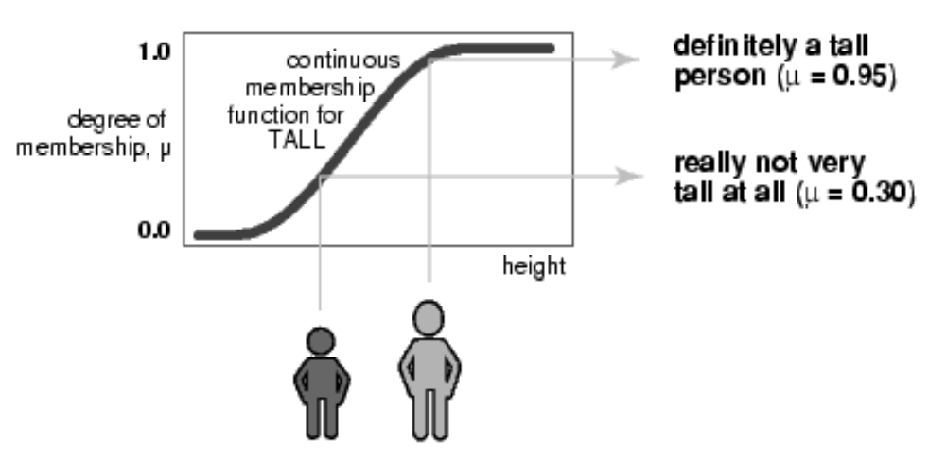
What is Lost……
Characteristics of fuzziness:
Word based, not number based.
Nonlinear dynamic.
Analog (ambiguous), not digital (Yes/No).

Slide 10
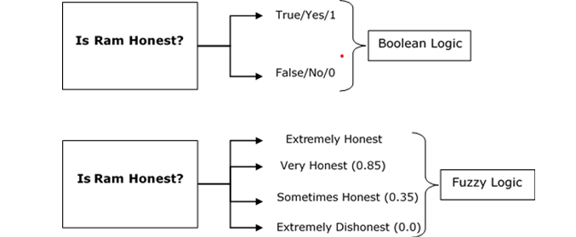

Slide 11
Fuzzy Systems and Uncertainty
Two broad categories of uncertainty methods—probabilistic and nonprobabilistic.
Probabilistic and statistical techniques are generally applied throughout the natural and social sciences and are used extensively in artificial intelligence.
Several nonprobabilistic methods have been devised for problem solving problems.
In addition to fuzzy logic, they include default logic, the Dempster-Shafer theory of evidence, endorsement-based systems, and qualitative reasoning.

Slide 12
Probability and Bayesian Methods
Probability theory is a formal examination of the likelihood (chance) that an event will occur, measured in terms of the ratio of the number of expected occurrences to the total number of possible occurrences.
Probabilistic or stochastic methods describe a process in which imprecise or random events affect the values of variables, so that results can be given only in terms of probabilities.
Bayesian decision theory is a variation of probability theory that analyzes past uncertain situations and determines the probability that a certain event caused the known outcome.

Slide 13
This analysis is then used to predict future outcomes
Bayes's rule considers the probability of two future events both happening.
Then, supposing that the first event occurs, takes the ratio of the probabilities of the two events as the probability of both occurring.
In other words, the greater the confidence in the truth about a past fact or future occurrence, the more likely the fact is to be true or the event to occur.

Slide 14
Fuzziness is synonymous to inexactness.
Difference between Probability and Fuzziness.
When it is appropriate to use Fuzzy Logic?
Fuzzy Logic and Fuzzy sets are based on the way the brain deals with inexact information.
In precise, scientific tests and measurements also used “fuzzy” logic in intuitive manner to evaluate results, symptoms, relationships, causes, or remedies.
Fuzzy systems afford a broader, richer field of data and manipulations than do more traditional methods.

Slide 15
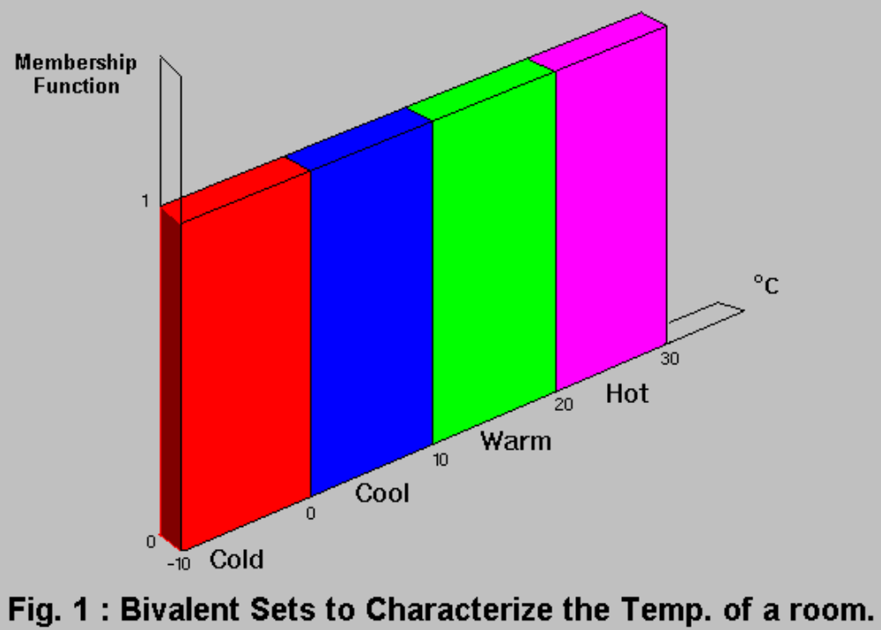
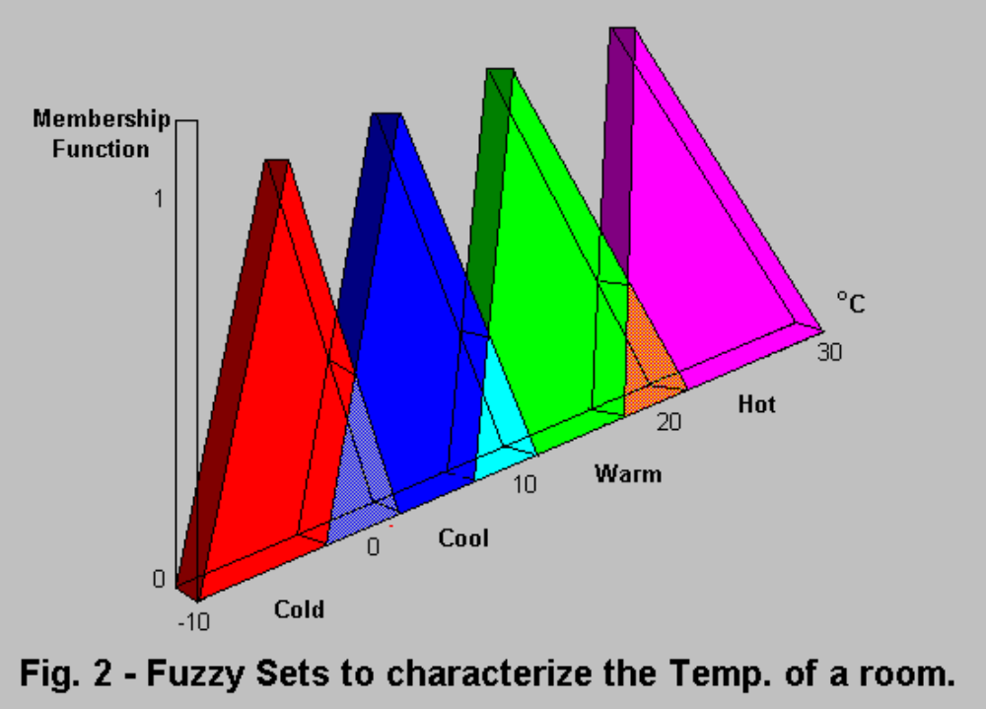
Bivalence and Fuzzy

Slide 16
Basics of Crisp sets
Generalization of Crisp Set.
  Crisp set:
  A Crisp set is a collection of distinct objects whose elements in a given universe of discourse are placed into two groups; Members and nonmembers.
    Let U be a universe of discourse, the characteristics function µ_{A}(x) of a crisp set A in U takes its values in [0,1].
  µ_{A}(x) = 1 if and only if x ∈ A
  = 0 otherwise.

Slide 17
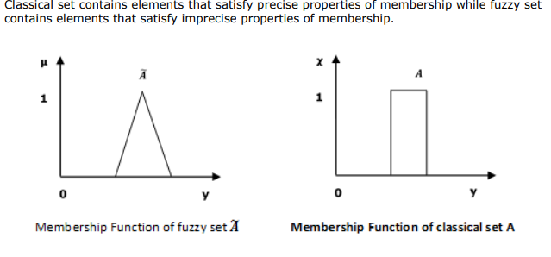

Slide 18
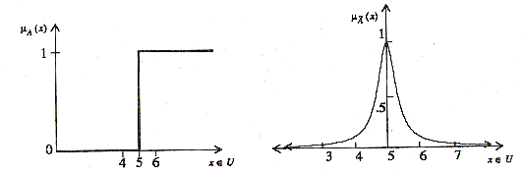
Example
U be the real line ℜ and crisp set A represents “real numbers greater than and equal to 5”;
  A={ (x, µ_{A}(x))⎪x ∈ U }, µ_{A}(x) = 0 x < 5
  = 1, x ≥ 5
  fuzzy set A represents “real numbers close to 5”;
  A = { (x, µ_{A}(x)) ⎪ x ∈ U }, µ_{A}(x) = 1/1+10(x-5)²

Slide 19
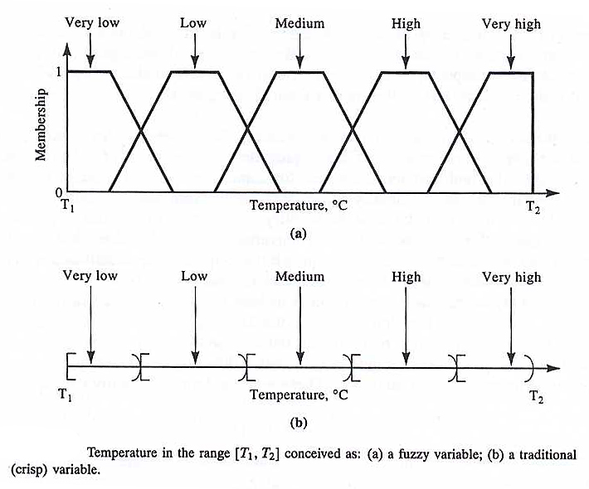
Fuzzy Sets
A fuzzy set A in the universe of discourse U can be defined as a set of ordered pairs, A = { (x, µ_{A}(x) ) ⎪ x ∈U }
µ_{A}(x) is the grade of membership of x in A
For fuzzy sets the range of membership function is [0,1].

Slide 20
Observations
The boundary of crisp set is rigid and sharp and performs a classification into two classes (x € A or x∉A)
The universe of discourse U is a crisp set.
A Fuzzy set introduces vagueness by eliminating the sharp boundary that divides members from nonmembers in a group.
The transition between full membership and nonmembership is gradual rather than abrupt.
Fuzzy sets may be viewed as an extension and generalization of crisp sets.

Slide 21
The crisp set always has unique membership fn., whereas every fuzzy set has an infinite no. of membership fns. This enables fuzzy systems to be adjusted for maximum utility in a given situation.
The membership fn. of a fuzzy set is subjective in nature; however it cannot be assigned arbitrarily.
Estimation of membership fn. is complicated and a better approach is to utilize the learning power of NNs to approximate them.
In fuzzy ∑µ_{A}(x) ≠ 1 unlike probability.

Slide 22
Membership Functions
The universe of discourse of a fuzzy set may exist for both discrete and continuous spectrum.
  the roll no. of students in a class is a discrete universe.
  weight of persons is a continuous universe.
X is not discrete, but is an interval of real numbers;
A = ∫ µ_{A}(x) / x, where ∫ indicates the union of the elements in A. X
Continuous universe is sometimes sampled at regular or irregular intervals for using it as a discrete universe.
Irriegular sampling: The membership curve of ‘young’ may be discretized at age x =18, 22, 24, 28.
Regular Sampling: the membership curve of ‘young’ may be sampled at age x =18, 20, 22, 24.

Slide 23
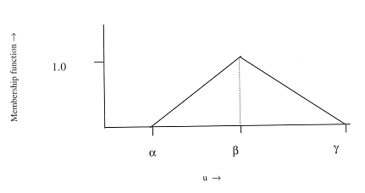
Triangular Membership function
The triangular membership fn. also called bell-shaped function with straight lines, can be defined as:
Λ(u; α, β, ϒ) = 0, u ≤ α
= (u - α) / (β - α), α < u ≤ β
= (α - u) / (β - α), β < u ≤ ϒ
= 0, u > ϒ

Slide 24
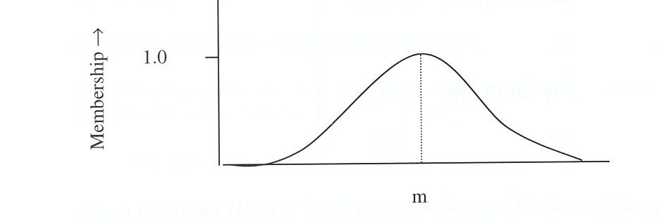
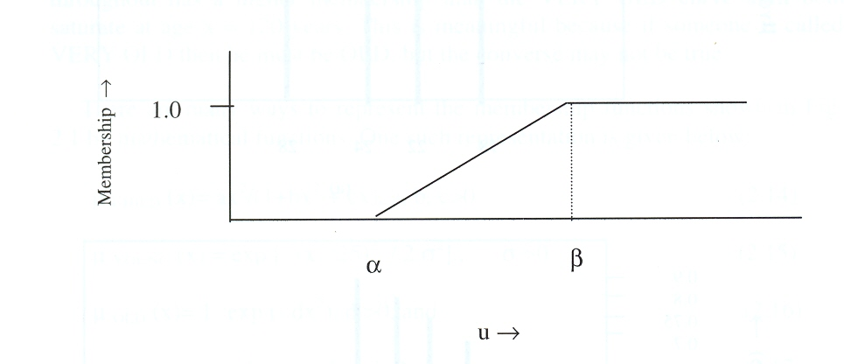
Membership Functions
A Gaussian membership function is defined as:
  G(u; m, σ) = exp [ - {(u-m)/ 2σ}2],
where m and σ control the mean and width of the membership function.
ϒ membership function is defined as:
ϒ (u; α, β) = 0 ; u ≤ α
= (u-α)/(β-α) ; α < u ≤ β
= 1 ; u > β

Slide 25
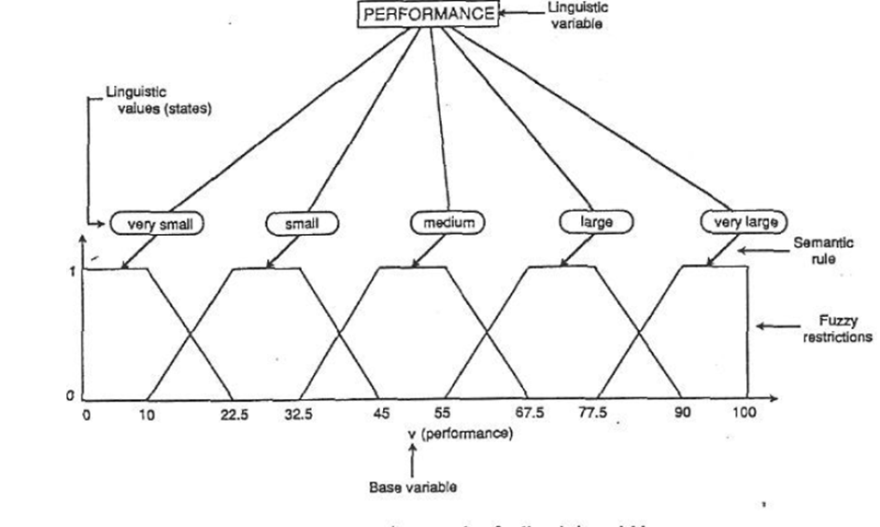
Linguistic variables

Slide 26
Basic Operations on Fuzzy Sets
The cardinality (or scalar cardinality) of a fuzzy set A : ⏐A⏐= ∑ µ_{A}(x) x∈U
Equality: A and B are equal if and only if µ_{A}(x) = µ_{B}(x), ∀x ∈ U
To check the degree of equality of two fuzzy sets, we can use the similarity measure:
E (A, B) ≡ degree (A = B) = ⏐A ∩ B ⏐ / ⏐ A ∪ B ⏐
When A = B, E (A, B) = 1;
when |A ∩ B| = 0, E (A, B) = 0.
In most general cases, 0 ≤ E (A, B) ≤ 1.

Slide 27
Operations on Fuzzy Sets
A is a subset of B; if and only if µ_{A}(x) ≤ µ_{B}(x), ∀x ∈ U
subsethood measure :S (A, B) = degree(A ⊆ B) = |A∩B | / | A |
⎯⎯ ⎯ ⎯
A ∪ B = A ∩ B,
A ∪ A ≠ U (law of the excluded middle) and A ∩ A ≠ ∅ (law of contradiction)

Slide 28
Intersection: µ_{A ∩ B} (x) = min [µ_{A}(x), µ_{B}(x)] = µ_{A}(x) ∧ µ_{B}(x);
∀x ∈ U
Union: µ _{A ∪ B} (x) = max [µ_{A}(x), µ_{B}(x)] = µ_{A}(x) ∨ µ_{B}(x); ∀x ∈ U
The Cartesian Product of A₁, A₂, …..,A_{n} is a fuzzy set in the product space U1 × U2 × ….× Un with membership function:
µ_{A1 × A2 × …. × An} (x₁, x₂, … x_{n}) = min [µ_{A1}(x₁), µ_{A2}(x₂), …µ_{An}(x_{n})],
x₁ ∈ U1, x₂ ∈ U2, …, x_{n} ∈ Un
Algebraic sum: µ_{A+ B}(x) = µ_{A}(x) + µ_{B}(x) - µ_{A}(x) . µ_{B}(x)
Algebraic product: µ_{A.B}(x) = µ_{A}(x) . µ_{B}(x)
Bounded sum: µ_{A⊕B} (x) = min {1, µ_{A}(x) + µ_{B}(x)}
Bounded difference: µ_{AΘB}(x) = max {0, µ_{A}(x) - µ_{B}(x)}

Slide 29
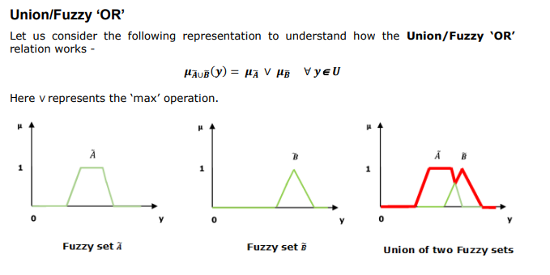

Slide 30
Fuzzy T-Norm
the intersection of the fuzzy sets, characterized by a T-norm operator: µ_{A ∩ B} (x) = T [µ_{A}(x), µ_{B}(x)]
for any membership values a, b, c and d, the T-norm operator :
T(0,0)=0, T(a,1)=T(1,a)=a (boundary)
T(a,b) ≤ T(c,d) if a≤c and b≤d (monotonicity)
T(a,b)=T(b,a) (commutativity)
T(a, T(b,c))=T(T(a,b),c) (associativity)
Def.: A function T:[0,1] × [0,1] → [0,1] that satisfies the above 4 characteristics is called a T-norm.

Slide 31
Fuzzy S-Norm
The union of the fuzzy sets, characterized by a S-norm (T-co-norm) operator: µ_{A ∪ B} (x) = S [µ_{A}(x), µ_{B}(x)]
S(1,1) = 1, S(a, 0) = S(0, a) = a (boundary)
S(a, b) ≤ S(c, d) if a ≤ c and b ≤ d (monotonicity)
S(a, b) = S(b, a) (commutativity)
S(a, S(b, c)) = S(S(a, b), c) (associativity)
Def.: A function S:[0,1] × [0,1] → [0,1] that satisfies the above 4 characteristics is called a S-norm.

Slide 32
FUZZY RELATION

Slide 33
Crisp Relation
Relationship between the colours of a fruit X and the grade of maturity Y
X = {green, yellow, red}
Y = {verdant, half-mature, mature}
Crisp formulation of a relation X →Y
 | verdant | half-mature | mature
green | 1 | 0 | 0
yellow | 0 | 1 | 0
red | 0 | 0 | 1

Slide 34
Crisp Relation Set
Relation is a new kind of crisp set expressed by rules:
Rule 1: If the colour of the fruit is green then the fruit is verdant.
Rule 2:If the colour of the fruit is yellow then the fruit is half-mature.
Rule 3: If the colour of the fruit is red then the fruit is mature.

Slide 35
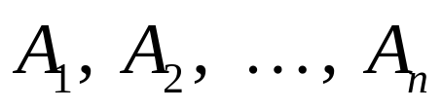

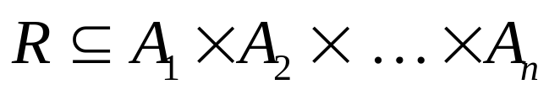
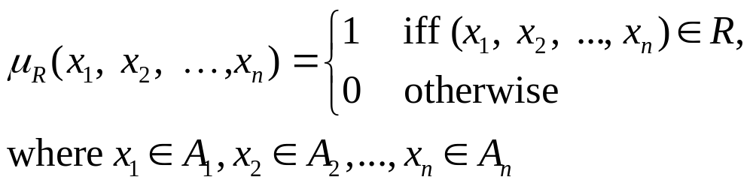
Crisp Relation
A relation among crisp sets is a subset of the Cartesian product. It is denoted by
Using the membership function defines the crisp relation R :

Slide 36
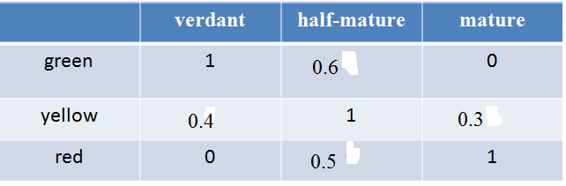
Fuzzy Relation

Slide 37
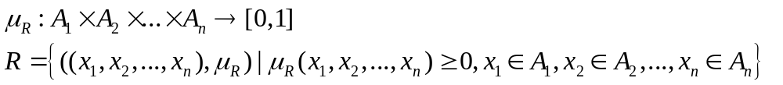
Fuzzy Relation
A fuzzy relation is a fuzzy set defined on the Cartesian product of crisp sets A₁, A₂, ..., A_{n} where tuples (x₁, x₂, ..., x_{n}) may have varying degrees of membership within the relation.
The membership grade indicates the strength of the relation present between the elements of the tuple.

Slide 38
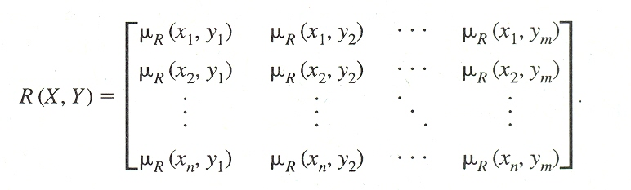
Fuzzy Relation
X = { x₁, x₂, …..x_{n} } and Y={y₁,y₂, …..y_{m} }, R(X,Y) can be expressed by an n×m matrix as
Ex. X={x₁, x₂, x₃} and Y={y₁, y₂} and R(x_{i}, y_{j}), represents the distance between x_{i} and y_{j} close to zero for all x∈X and for all y∈Y.
R(x_{i}, y_{j}) = exp[-(x_{i} - y_{j})²].
The expression describes “X close to Y”.

Slide 39
Composition Operation
Fuzzy relation R1 and R2 defined on X×Y, Y×Z, respectively.
The max-min composition of R1 and R2 is a fuzzy set,
R3=R1°R2= {μ_{R3}(x,z)}=max{min(μ_{R1}(x,y),μ_{R2}(y,z))| x∈X,y∈Y,z∈Z
y
The min-max composition of R1 and R2 is a fuzzy set,
R3=R1°R2= {μ_{R3}(x,z)}=min{max(μ_{R1}(x,y),μ_{R2}(y,z))| x∈X,y∈Y,z∈Z
y
There is max-min and min-max composition for set-relation compositions.
A be a fuzzy set on X and R(X,Y) is a fuzzy relation on X×Y,
μ_{A°R} (y)=max min[(μ_{A}(x), μ_{R}(x,y)]; for all y∈Y,
x∈X

Slide 40
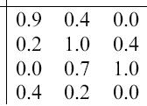
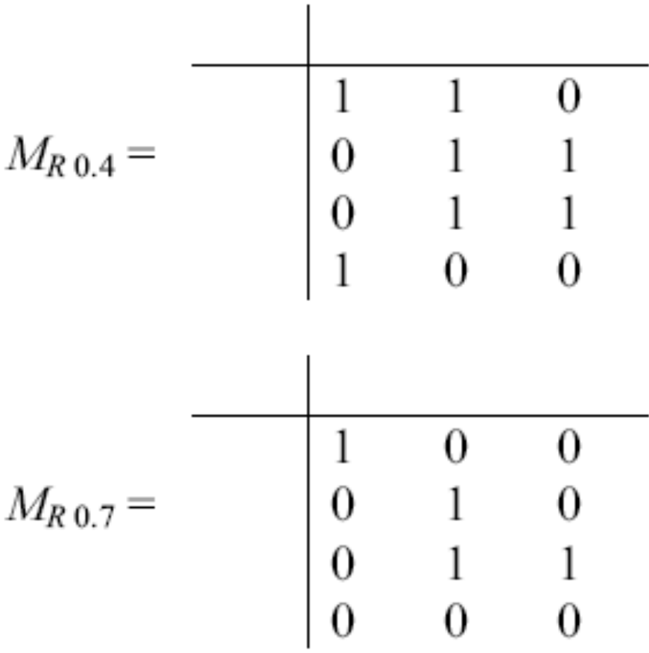
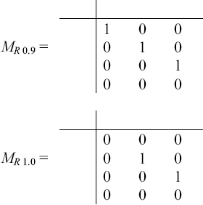
α-cut of fuzzy relation

Slide 41
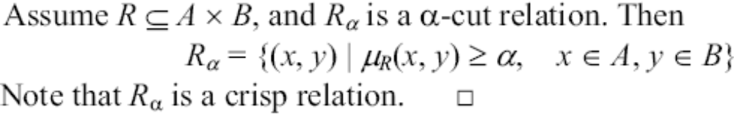
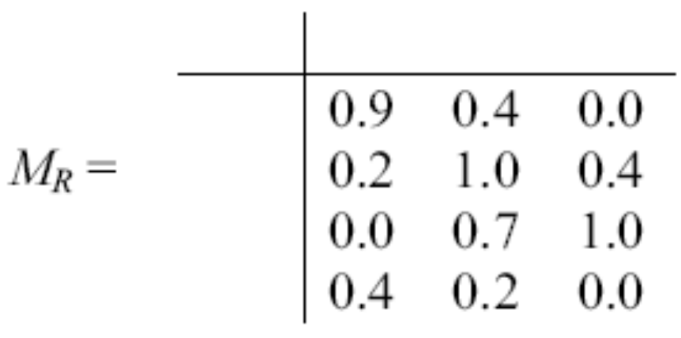
α-cut of fuzzy relation
Example

Slide 42
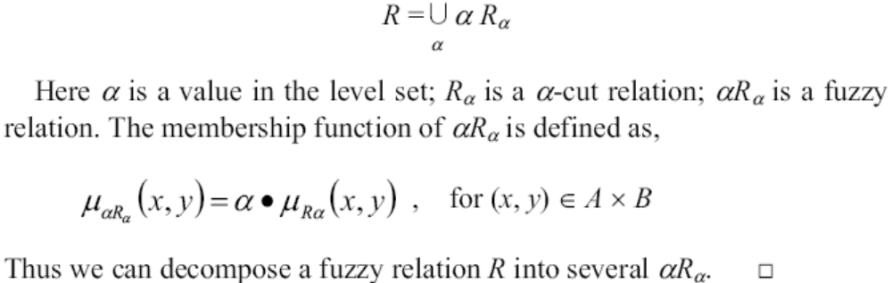
Decomposition of relation

Slide 43
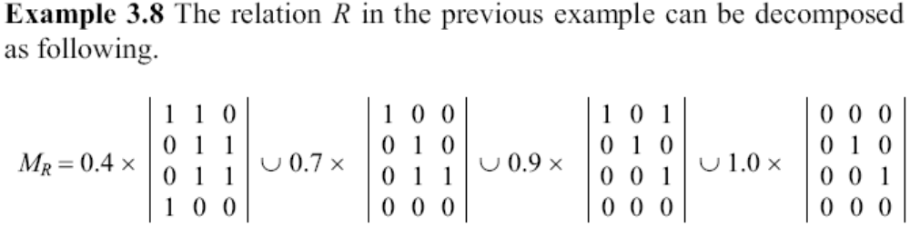
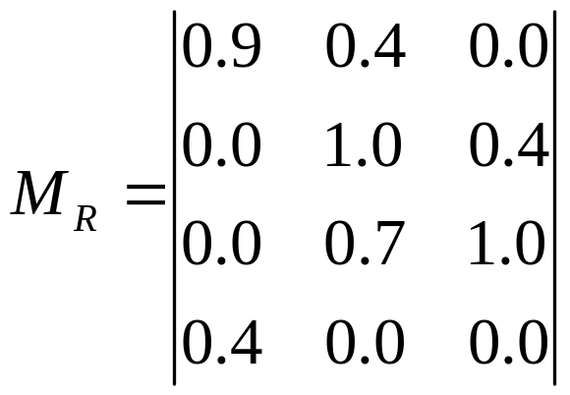
Decomposition of relation
0

Slide 44
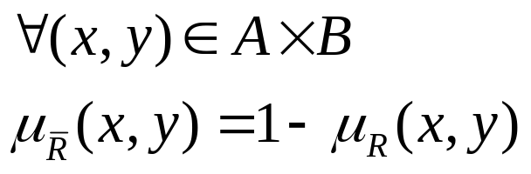
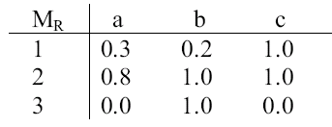
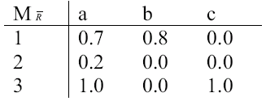
Operations on fuzzy relations
Complement relation:
Example

Slide 45
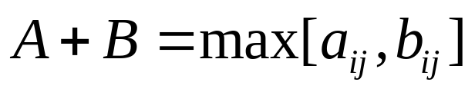
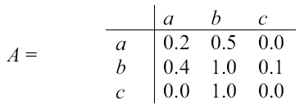
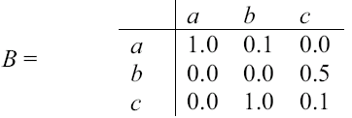
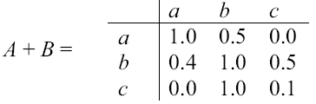
Operations on fuzzy matrices
Sum:
Example

Slide 46
FUZZY IMPLICATION RELATIONS
If x is A1(p) Then y is B1(q) is denoted by: R1(x,y)={μ_{R1}(x,y)/(x,y)}
μ_{R1}(x,y) is constructed by
(i) Dienes-Rescher Implication: Max[1- μ_{A1}(x),μ_{B1}(y)] ; p→q:~p∨q
(ii) Lukasiewicz Implication: Min[1,1- μ_{A1}(x)+ μ_{B1}(y)] ; Replace negation by 1’s complement and logical OR by ‘+’.
(iii) Mamdani Implication: Min[μ_{A1}(x), μ_{B1}(y)] or μ_{A1}(x).μ_{B1}(y)
(iv) Zadeh Implication: Max[Min[μ_{A1}(x), μ_{B1}(y), 1- μ_{A1}(x)]; p→q can be stated as “either p and q are true or p is false” (p∧q)∨(~p).
(v) Godel Implication: μ_{R1}(x,y)=1 if μ_{A1}(x)≤ μ_{B1}(y)
= μ_{B1}(y) otherwise

Slide 47
Binary Fuzzy Relations
Binary Fuzzy relations on a single set X.
Different types of binary fuzzy relations are distinguished by three basic properties:
reflexivity, Symmetry and Transitivity.
A fuzzy relation R(X,X) is reflexive ; iff μ_{R}(x, x)=1; x ∈ X.
R(X,X) is symmetric; iff μ_{R}(x,y)= μ_{R}(y,x); for all x,y ∈ X.
R(X,X) is Transitive; iff μ_{R}(x,y) ≥ max min[μ_{R}(x,y), μ_{R}(y,z)];
y∈Y
∀(x,z)∈X²

Slide 48
Similarity Relation
A binary fuzzy relation which is reflexive, symmetric and transitive binary fuzzy relation is called Similarity Relation.
Similarity relations are the generalization of equivalence relations in binary crisp relations to binary fuzzy relations.
A binary crisp relation C(X,X) is called an equivalence relation if it satisfies Reflexivity: (x, x)∈C(X, X) for every x ∈X
Symmetry: If (x,y)∈C(X, X) then (y, x)∈C(X, X), x,y ∈ X
Transitivity: : If (x,y)∈C(X, X) and (y, z)∈C(X, X), then (x,z) ∈ C(X,X), x,y,z ∈ X

Slide 49
Fuzzy Logic
Fuzzy Logic is an extension of Classical two-valued logic.
Corresponds between fuzzy set theory and fuzzy logic.
The degree of an element in a fuzzy set may corresponds to the truth value of a proposition in Fuzzy Logic.
Linguistic variables and Approximate Reasoning are two important concepts in fuzzy logic.
A Linguistic variable is a variable whose values are words or sentences in a natural language.
Temperature is a linguistic variable if it takes the values such low, high, very high
The concept of linguistic variables provide a means of approximate characterization of phenomena that are too complex or too ill defined to be amanable to description in conventional quantitative terms

Slide 50
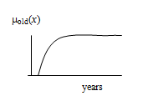
Linguistic variables and linguistic truth value is associated with fuzzy proposition.
Fuzzy variable: (X,U,R(X)); X: name of the variable, R(X): A fuzzy subset of U, represents a fuzzy restriction imposed by X.
Ex. X=‘old’; U={10,20, …., 80}; R(X)=0.1/20+0.2/30+0.4/40+0.5/50+0.8/60+1/70+1/80
A linguistic variable is a variable of higher order than a fuzzy variable and takes fuzzy variables as its values.

Slide 51
Linguistic Variables
linguistic variable: ”speed”; value: ‘slow’, ‘fast’, ‘very fast’.
Linguistic variable : (x, T(x), U, G, M)
x: name of the variable; “speed”; T(x): term set of x;
T(speed)={very slow, slow, moderate, fast …..}
U=[0,100];
G: syntactic rule for generating the names of the elements in T(speed), is quite intuitive.
M=semantic rule; M(slow): the fuzzy set for “a speed below about 40 miles per hour” with membership function μ_{slow}

Slide 52
Linguistic Variables
A linguistic variable x is said to be structured if its term set T(x) and its semantic rule M can be characterized algorithmically.
Linguistic hedge h, is a modifier and act as an operator for modifying the meaning of a fuzzy set A, represented as h(A).
Create a new fuzzy set h(A) from fuzzy set A.
“very young”; “very” is the linguistic hedge applied on fuzzy set “young”.

Slide 53
Linguistic Hedges
Frequently used fuzzy set operation in defining linguistic hedge:
Concentration: CON(A); μ_{CON(A)} (u) = (μ_{(A)}(u))²
Dilation: DIL(A); μ_{DIL(A)} (u) = (μ_{(A)}(u))^{1/2}
Intensification: INT(A);
μ_{INT(A)} (u) = 2(μ_{(A)} (u))² μ_{(A)}(u)∈[0, 0.5]
1 -2 (1 - μ_{(A)} (u))², otherwise
VERY(A) = CON(A) = A²; μ_{(A)}(u )= (μ_{A}(u))²;
Highly(A) = A³; FAIRLY= A^{1/2}

Slide 54
Structured Linguistic Variable
T(age) = {Old, Very Old, Very Very Old….}
Old is called primary term and the corresponding syntactic rule G, can generate the term set T(age) recursively, like:
T⁰ = ∅, T¹ = {Old}, T² = (old, very old} ….
M(T^{i} ) = Old^{i} ; i = 1, 2, 3…..
The semantic rule M can associate with each T^{i}, generate meaning recursively
“age” is Structured Linguistic Variable

Slide 55
Fuzzy Proposition: Fuzzy Predicates, fuzzy predicate modifiers, fuzzy quantifiers and fuzzy qualifiers.
“Mary is Young”; “young” is fuzzy predicate.
“The house is extremely expensive”; “extremely” is fuzzy predicate modifier.
”Many students are happy”; “Many” is fuzzy quantifier.
(John is old) is Not Very True; “Not Very True” Fuzzy qualifier.

Slide 56
DRAWBACK OF PRODUCTION SYSTEM
IF (Height is Tall) THEN (Speed is High) , KB: ”Height is VERY TALL”,
No exact match occurs with the antecedent.
In FL rule fires, inference: “Speed is Very High”.
Extension in Fuzzy Domain: IF (a banana is YELLOW) THEN (it is RIPE).
VERY YELLOW, MORE-OR-LESS YELLOW, RIPE, VERY RIPE and MORE-OR-LESS-RIPE.
Firing of these rules happen concurrently: “color” of the banana.
“The banana is Yellowish” semantically close to “YELLOW”, “VERY YELLOW”…..
“MORE-OR-LESS TRUE” or “ALMOST TRUE” is decided as “TRUE” in FL.

Slide 57
Machine Learning
AI systems need the ability to acquire their own knowledge, by extracting patterns from raw data.
This capability is known as machine learning.
The introduction of ML allowed computers to tackle problems involving knowledge of the real world and make decisions that appear subjective.
A simple ML algorithm called logistic regression.
The performance of simple ML algorithms depends heavily on the representation of the data, known as features.

Slide 58
Data Representation
Logistic regression learns how each of these features of the patient correlates with various outcomes. However, it cannot influence the way that the features are defined in any way.
If logistic regression was given an MRI scan of the patient, rather than the doctor’s formalized report, it would not be able to make useful predictions. Individual pixels in an MRI scan have negligible correlation with any complications.
The choice of representation has an enormous effect on the performance of machine learning algorithms. However, for many tasks, it is difficult to know what features should be extracted.

Slide 59

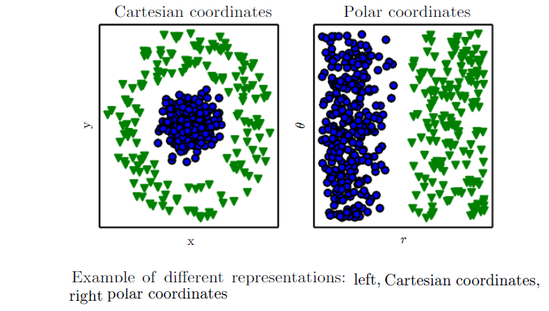
Classification by drawing a line

Slide 60
Linguistic Approximation
Linguistic approximation is a procedure for determining a term from the term set of a linguistic variable which is semantically closest to a given fuzzy set.
The solution is intuitive, and there is a lack of general theory.
An algorithm was proposed by Esragh and Mamdani, however; time complexity of the algorithm is quite high.
The algorithm is simplified for some special type of fuzzy sets.

Slide 61
Similarity Measures
Linguistic approximation based on Similarity Measures.
The similarity measure of two fuzzy sets E(A,B) indicates the degree of equality of two fuzzy sets A and B.
| A∩B |
E(A, B) =
|A∪B |
E(A,B) approaches to 1 when A and B are more similar
Linguistic approximation of a given fuzzy set A is the term T_{A}∈T(x), which is the most similar to A compared to other terms in the term set T(x) of a given linguistic variable.
E(A, T_{A}) = max E(A, T_{i})
T_{i}∈T(x)

Slide 62
Given U = {0, 0.1, 0.2, …, 1} and the term set {A, B, C} of the linguistic variable truth where
A = “True” = [{0.7,0.8}, {1,0.9}, {1,1}]
B =“More or Less True”=[{0.5,0.6},{0.7,0.7},{1,0.8},{1,0.9}, {1,1}]
C = “Almost True” = [{0.6,0.8}, {1,0.9},{0.6,1}]
Find the linguistic approximation of the fuzzy set D defined by- D = [{0.6,0.8}, {1,0.9}, {1,1}]
E(D,A) = 2.6/2.7 = 0.96, E(D,B) = 2.6/4.2 = 0.62,
E(D,C) = 2.2/2.6 = 0.85
The linguistic approximation of the fuzzy set D is the term A, “True”

Slide 63
Propositions in Logic
Classical bivalence logic deals with propositions having value either true (logic value 1) or false (logic value 0).
Propositions are sentences expressed in some language and expressed in a canonical form:- x is P, where x is a symbol of the subject and P designates the predicate which characterizes a property of the subject.
A proposition and its negation are required to assume opposite truth values.
Two concerns of logic: logic operations and logic reasoning

Slide 64
Logic Operations
Logic operations are logic functions of two propositions and defined by truth values.
Consider two propositions A and B, either of which can be true or false.
Basic logic operations are conjunction (A and B), disjunction (A or B), implication (if A then B) and equivalence (A if and only if B)

Slide 65
Logic is a basis for Reasoning
Inference Rules:
Modus Ponens: (A ∧ (A → B) ⇒ B, i.e. inference B.
Modus Tollens: ∼B∧(A→B)⇒ ∼A, i.e. inference ∼A.
Hypothetical Syllogism:(A → B) ∧ (B → C) ⇒ A → C
The inferred propositions are always true no matter what the truth values of propositions A and B, called tautologies.
Modus ponens are related to Forward data driven inference and useful for fuzzy logic control.
Modus tollens is closely related to the backward goal driven inference usually used in Expert Systems

Slide 66
GENERALIZED MODUS PONEN:
IF x is A THEN y is B; Given: x is A′; Inferred: y is B ′
μ_{B’}(y) = μ_{A} ′(x) ° μ_{R}(x, y)
GENERALIZED MODUS TOLLEN:
IF x is A THEN y is B; Given: y is B ′; Inferred: x is A ′
μ_{A} ′(x) = μ_{B} ′(y) ° [μ_{R}(x, y)]^{T}
Fuzzy Logic is an extension of set -theoretic Bivalence Logic in which the truth values are terms of the linguistic variable truth

Slide 67
Definition of fuzzy logic:
A form of knowledge representation suitable for notions that cannot be defined precisely, but which depend upon their contexts.

Slide 68
Approximate Reasoning
The final conclusion is approximate rather than exact.
Multiple Antecedent clauses:
If (x is A) AND (y is B) Then (z is C); Where x∈X, y∈Y and z∈Z
T[μ_{A}(x),μ_{B}(y)] = antecedent membership distribution.
μ_{R}(x, y; z):implication rule; μ_{A’}(x) and μ_{B’}(y) are supplied. Find out μ_{C’}(z).
μ_{C’}(z)= t(μ_{A’}(x),μ_{B’}(y)) o μ_{R}(x, y; z)
IF (height is TALL) and (weight is MODERATE) THEN (Speed is HIGH).

Slide 69
μ_{TALL}(height)={0.5/5’,0.8/6’,1.0/7’};
μ_{MODERATE}(weight)={0.7/45kg,0.9/50kg}
μ_{HIGH}(speed)={0.6/6m/s, 0.8/8m/s, 0.5/9m/s}
Given:μ_{TALL’}(height)={0.6/5’,0.7/6’,0.9/7’};
μ_{MODERATE’}(weight)={0.8/45kg,0.7/50kg}
Find out: μ_{HIGH’} (speed)

Slide 70
Assume TALL’ = TALL, MODERATE’= MODERATE and HIGH’= HIGH
Antecedent membership distribution = T(μ_{TALL}(height), μ_{MODERATE}(weight))
={(0.5^0.7/5’, 45kg), (0.5^0.9/5’, 50kg), …………}
μ_{R} (height, weight; speed): implication rule.
Lukasiewicz function: μ_{R}(5’, 45kg; 6m/s)=Min[1, 1-0.5 +0.6]=1.0
6m/s 8m/s 9m/s
5’,45kg 1 . .
5’,45kg
5’,45kg
5’,45kg
5’,45kg
5’,45kg
μ_{HIGH’}(speed) =
T(μ_{TALL’} (height),μ_{MODERATE’}(weight))oμ_{R}(height,weight; speed)

Slide 71
Fuzzy Inference Systems
A Fuzzy Inference System (FIS) is a way of mapping an input space to an output space using fuzzy logic.
FIS uses fuzzy membership functions and rules.
The rules in FIS are fuzzy production rules of the form:
  if p then q, where p and q are fuzzy statements.
For example, in a fuzzy rule
  if x is low and y is high then z is medium.
  x is low; y is high; z is medium are fuzzy propositions
  x and y are input linguistic variables; z is an output linguistic variable
  low, high, and medium are fuzzy sets.

Slide 72
The antecedent describes to what degree the rule applies, while the conclusion assigns a fuzzy function to each of one or more output variables.
Most tools for working with fuzzy expert systems allow more than one conclusion per rule.
The set of rules in a fuzzy expert system is known as knowledge base.
The functional operations in fuzzy expert system proceed in the following steps.
  Fuzzification
  Fuzzy Inferencing (apply implication method)
  Aggregation of all outputs
  Defuzzification

Slide 73
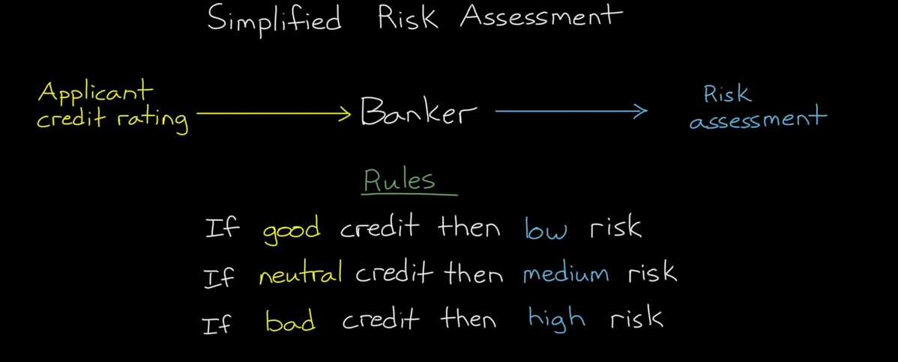

Slide 74
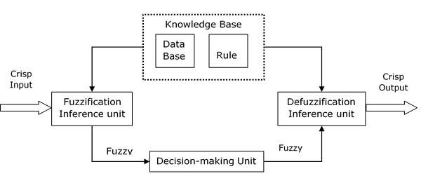
Functional Blocks of FIS
Methods of FIS
Two important methods of FIS, having different consequent of fuzzy rules −
Mamdani Fuzzy Inference System
Takagi-Sugeno Fuzzy Model (TS Method)

Slide 75
Fuzzification
In fuzzification process, membership functions defined on input variables are applied to their actual values so that the degree of truth for each rule premise can be determined.
Fuzzy statements in the antecedent are resolved to a degree of membership.
  If there is only one part to the antecedent, then this is the degree of support for the rule.
  If there are multiple parts to the antecedent, apply fuzzy logic operators and resolve the antecedent to a single number between 0 and 1.
Antecedent may be joined by OR; AND operators.
  For OR -- max
  For AND -- min

Slide 76
Fuzzy Inferencing
The process of inference for each rule:
  Truth value for the premise of each rule is computed and applied to the conclusion part of each rule.
  A fuzzy set is assigned to each output variable in each rule.
The use of degree of support for the entire rule shape the output fuzzy set.
Combining the fuzzified inputs according to the fuzzy rules to establish a rule strength
Finding the consequence of the rule by combining the rule strength and the output membership function.

Slide 77
If the consequent of a rule has multiple parts, then all consequents are affected equally by the result of the antecedent.
The consequent specifies a fuzzy set to be assigned to the output.
The implication function then modifies that fuzzy set to the degree specified by the antecedent.
Functions are used in inference rules.
min or prod are commonly used as inference rules.
  min: truncates the consequent's membership function
  prod: scales it.

Slide 78
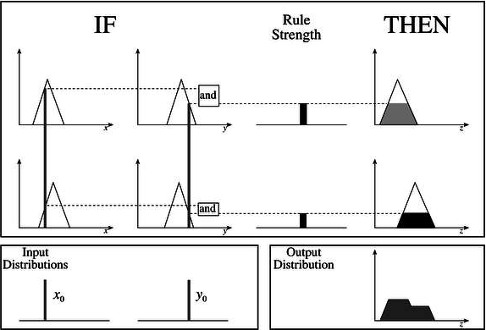
Mamdani Fuzzy Inference System

Slide 79
Takagi-Sugeno Fuzzy Model (TS Method)
This model was proposed by Takagi, Sugeno and Kang in 1985
IF x is A and y is B THEN Z = f(x,y)
Here, A and B are fuzzy sets in antecedents and Z = f(x,y) is a crisp function in the consequent.
if 7 = x and 9 = y then output is z = ax+by+c

Slide 80
Aggregation of outputs
In this process the outputs of each rule are combined into a single fuzzy set.
The input of the aggregation process is the list of truncated output functions returned by the implication process for each rule.
The output of the aggregation process is one fuzzy set for each output variable.
  Here, all fuzzy sets assigned to each output variable are combined together to form a single fuzzy set for each output variable using a fuzzy aggregation operator.
Some of the most commonly used aggregation operators are
  the maximum : point-wise maximum over all of the fuzzy sets
  the sum : (point-wise sum over all of the fuzzy
  the probabilistic sum.

Slide 81
Defuzzification
In Defuzzificztion, the fuzzy output set is converted to a crisp number.
Some commonly used techniques are the centroid and maximum methods.
  In the centroid method, the crisp value of the output variable is computed by finding the variable value of the centre of gravity of the membership function for the fuzzy value.
  In the maximum method, one of the variable values at which the fuzzy set has its maximum truth value is chosen as the crisp value for the output variable.
Other methods for defuzzification are:
  bisector, middle of maximum (the average of the maximum value of the output set), largest of maximum, and smallest of maximum, etc.

Slide 82
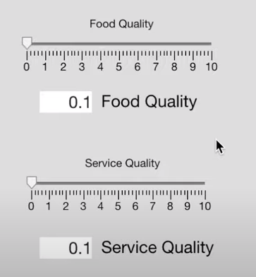
Generic Method
Two inputs : Quality of food and Service at a restaurant rated at scale from 0-10
One output: Amount of tip to be given
Tip should reflect the quality of the food and service.
The tip might be in the range 5-15% of total bill paid.

Slide 83
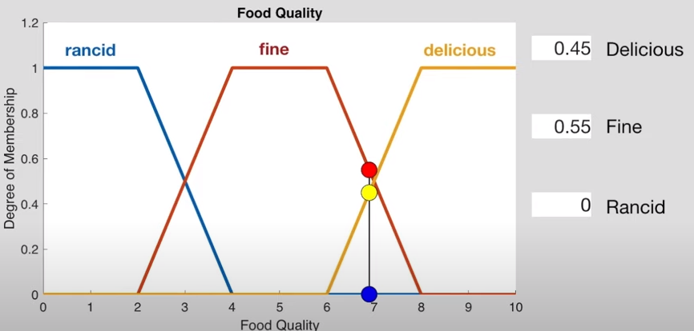
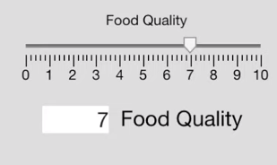
Fuzzification of Food Quality
Food is described as Fine, Delicious and Rancid and corresponding membership functions

Slide 84
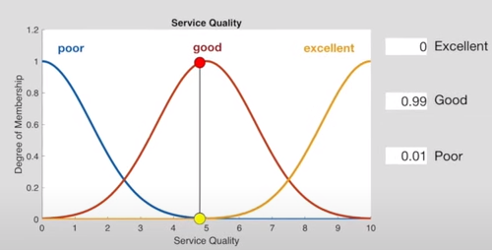
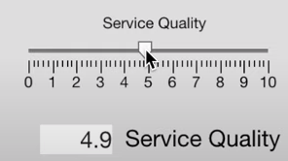
Fuzzification of Service Quality

Slide 85
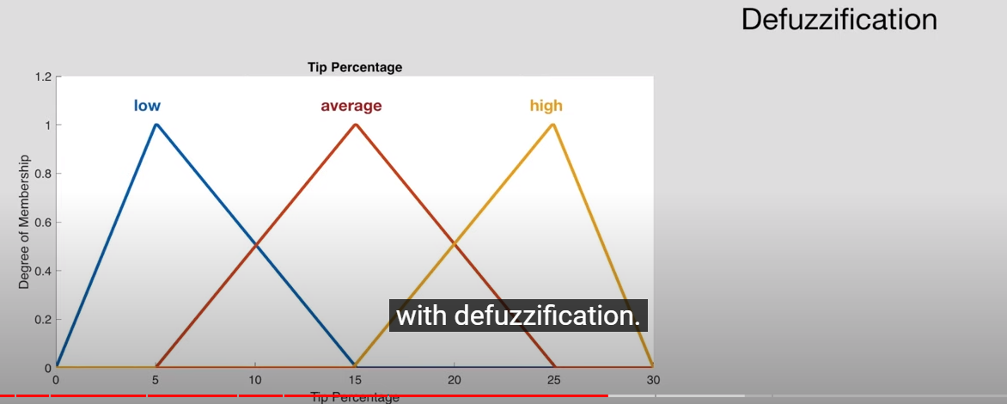
Tip Membership functions

Slide 86
Rules for Tipping
Let us consider the following three rules
  If service is poor or food is rancid, then tip is low
  If service is good, then tip is average
  If service is excellent or food is delicious, then tip is high
Input variables
  Service : represented by poor, good, excellent
  Food : represented by poor, delicious
Output Variable:
  Tip : represented by low, average, high

Slide 87
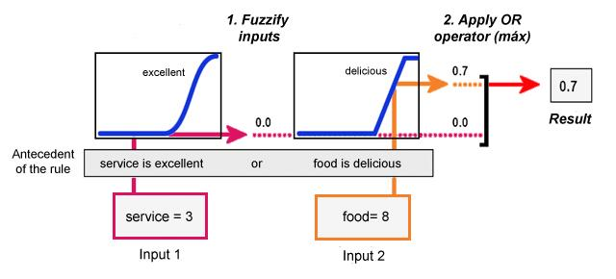
Antecedent for each rule

Slide 88
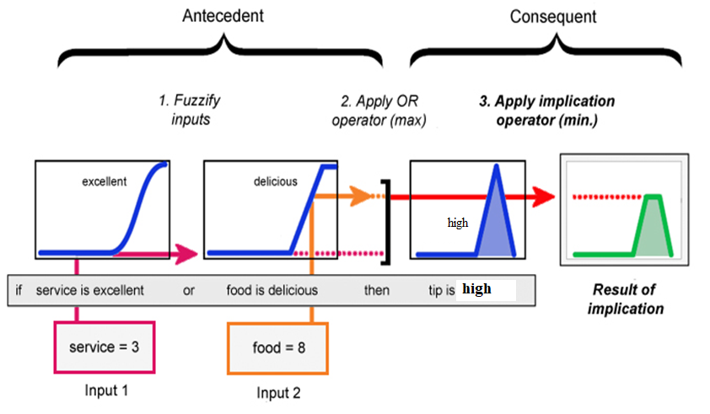
Rule's Conclusion

Slide 89
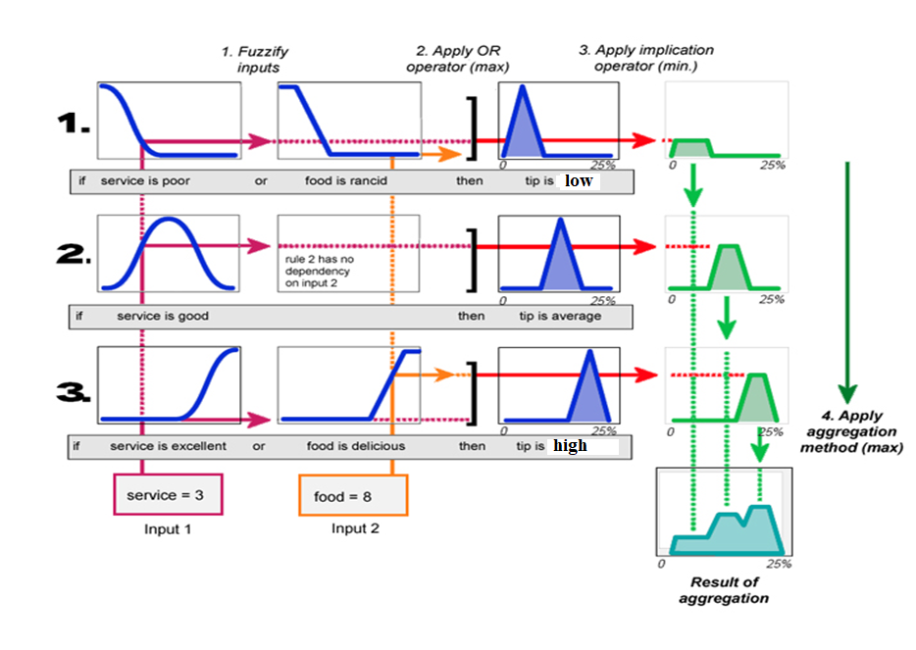
Aggregate Conclusions

Slide 90
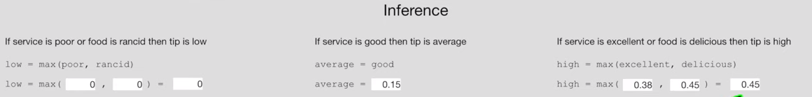

Slide 91
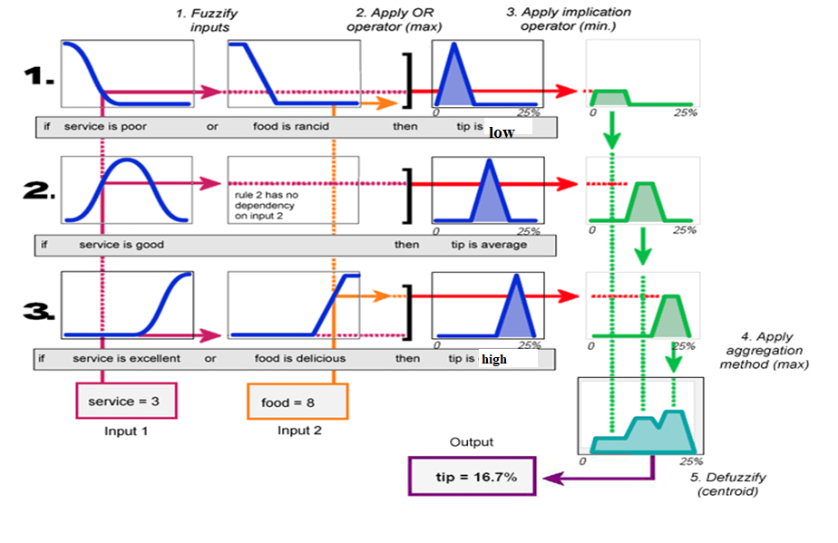
Summarization

Slide 92

Defuzzification

Slide 93
APPLICATIONS OF FUZZY THEORY

Slide 94
FUZZY PATTERN RECOGNITION
In real-life we deal with complex patterns.
Pattern recognition involves the search for structure in the complex patterns.
Fuzzy set theory well accepted methodology for pattern recognition.
Pattern recognition usually consists of (1) data acquisition (2) feature selection (3) categorization.

Slide 95
UNCERTAINTY IN PATTERN RECOGNITION PROCESS
Uncertainty in the feature space.
Uncertainty in the classification space.
Human beings express and process data in nonnumerical levels.
Classification is performed by relationships.
Classification rule: If an object is heavy and small and it moves fast, then it probably belong to the class ω_{i}

Slide 96
Fuzzy Pattern Recognition
Pattern recognition partitions a set of patterns into classes depending on the similarity in features of the patterns.
If Features are not very distinct, pattern classes overlap.
Fuzzy pattern recognition capable of partitioning the patterns by soft boundaries.
Patterns are classified into one or more classes with a certain degree of membership to belong to each class.
Fuzzy Clustering Algorithm
Classify a given set of p dimensional data points into a set of c fuzzy classes.

Slide 97
PHYSICAL DATA
DATA ACQUISITION VIA SENSORS
PATTERN SPACE
DIMENSIONALITY REDUCTION VIA FEATURE SELECTION
FEATURE SPACE
CLASSIFICATION VIA CLASSIFIER
CLASSIFICATION SPACE
CLASSIFIED RESULT

Slide 98
The acquired data can be Numerical, Linguistic or both.
Feature selection is performed to search for internal structure in the data.
Feature dimension has serious impact on classification procedure.
Finally classification is performed by a classifier, which is transformation between classes and features.

Slide 99
Definition
A cluster is a group of objects that are more similar to one another than to the members of other clusters
Similarity is often defined by means of a distance norm.
Data can reveal clusters of different geometrical shapes, sizes and densities
The performance of most clustering algorithms is influenced by the geometrical shapes, densities of the individual clusters and the spatial relations and distances among the clusters.

Slide 100
Hard Clustering vs. Soft Clustering
Hard clustering means partition of the data into mutually exclusive subsets.
Soft clustering allow the data points belong to different clusters.
The discrete nature of hard clustering has some difficulties with the objective functions which are not differentiable

Slide 101

Fuzzy C-means Clustering

Slide 102
It is an unsupervised clustering algorithm that permits us to build a fuzzy partition from data.
The algorithm depends on a parameter m which corresponds to the degree of fuzziness of the solution.
Large values of m will blur the classes and all elements tend to belong to all clusters.
The solutions of the optimization problem depend on the parameter m.
Different selections of m will typically lead to different partitions.

Slide 103

Fuzzy C-means Clustering
m is fuzzyness index > 1
Usually, m = 2

Slide 104




Fuzzy C-means Clustering
For example: we have initial centroid 3 & 11
(with m=2)
For node 2 (1st element):
U11 =
The membership of first node to first cluster
U12 =
The membership of first node to second cluster

Slide 105
Fuzzy rule-based classifiers
IF x1 is medium AND x2 is small THEN class is 1
IF x1 is medium AND x2 is large THEN class is 2
IF x1 is large AND x2 is small THEN class is 2
IF x1 is small AND x2 is large THEN class is 3
Two features X={x1, x2} are numerical but the rules use linguistic values represented by fuzzy sets using a membership function.
If there are M possible linguistic values for each feature, and n features in the problem, the number of possible different if-then rules of this conjunction type (AND) is M^{n}.

Slide 106
The degree of satisfaction of the antecedent part of the rule determines the firing strength of the rule.
The firing strength is implemented as minimum.
The rule "votes" for the class with weight τ₁(x)
To find output of the classifier, the votes of all rules are aggregated.
maximum aggregation method: The soft class label for x consists of membership values g_{k}(x)∈[0,1] , k=1,...,c , where c is the number of classes. Let i→k denote that rule i votes for class k. Then g_{k}(x) = max τ_{i}(x)
i→k
A crisp label for x is assigned to the class with the largest g_{k}(x)

Slide 107
Linguistic Labels as the consequent
IF x1 is medium AND x2 is small THEN class 1 is large AND class 2 is small AND class 3 is small.
The classifier in this case operates as a Mamdani-type fuzzy system.
The output is again a soft label containing the values of c discriminant functions.

Slide 108
FUZZY LOGIC CONTROL SYSTEMS
Fuzzy logic controller (FLC) is to incorporate the “expert experience” of a human operator in controlling a process.
Input-output relationship is described by the fuzzy control rules involving linguistic variables and approximate reasoning provides a means to incorporate human expert experience in designing the controller.
Architecture of FLC comprised of: A Fuzzifier, A Fuzzy Rule Base, An Inference Engine and a Defuzzifier.
The Fuzzifier transforms crisp measured data into linguistic value.
Fuzzy Rule base stores the knowledge of the operation of the process of domain experts.
The Inference Engine simulates human decision making by performing approximate reasoning to achieve a desired control strategy.
The defuzzifier yields a nonfuzzy decision from an inferred fuzzy control action.

Slide 109

Fuzzy Logic Control Systems

Slide 110
Fuzzy Input and Output
Bike rider: two inputs are speed and distance.
The next step is to identify the fuzzy ranges of each.
Four fuzzy speed ranges: Stopped (0-2mph), Slow (1-10 mph), Pretty Fast (5-30 mph), and Real Fast (25-50 mph)
Five fuzzy distance from stop sign ranges: At (0-5 ft), Real Close (0-40ft), Near (20=80 ft), Pretty Far (60-120 ft), and Real Far (100-165 ft)
One output: Brake Pressure- fuzzy braking ranges are None (0-1%), Light (1-30 %), Medium (25-75%), and Squeeze Hard (65-100%)

Slide 111
BikeBraker Rules
Write the rules that will translate the inputs into the actual outputs.
IF (you are At the stop sign) AND (you are Stopped) THEN (brake pressure is None)
IF (you are Real Close to the stop sign) AND (you are Stopped) THEN (rake pressure is None)
IF (you are Near the stop sign) and (you are Stopped) Then (brake pressure is None)

